Slide 1
Microsoft Movie Recommendations

Slide 2
Hello!
I’m Rachel Beery with the Flatiron Data Science Program!

Slide 3
Methods
Data were gathered from IMDB, TMDB, and The Numbers
Information about movie title, profit, domestic and worldwide gross, runtime, and IMDB user ratings was collected.

Slide 4

$42.5B
46,504,883
148,474,440
2019 Global Box Office
Mean Budget
Mean Gross Profit
https://www.billboard.com/articles/news/8547827/2019-global-box-office-revenue-hit-record-425b-despite-4-percent-dip-in-us#:~:text=Global%20box%20office%20revenue%20hit%20a%20record%20%2442.5%20billion%20in,%2411.88%20billion%2C%20according%20to%20Comscore.

Slide 5
Recommendations
What genres are the most profitable?
Action and adventure movies are the most profitable. Comedy, drama, and other genres show a positive return of investment.
Do movie ratings affect profitability?
There is not a strong positive correlation between movie ratings and gross profitability.
Does a movie’s runtime affect profitability?
Movies over 75 minutes in length are the most profitable.

Slide 6
What genres are the most profitable?
1

Slide 7
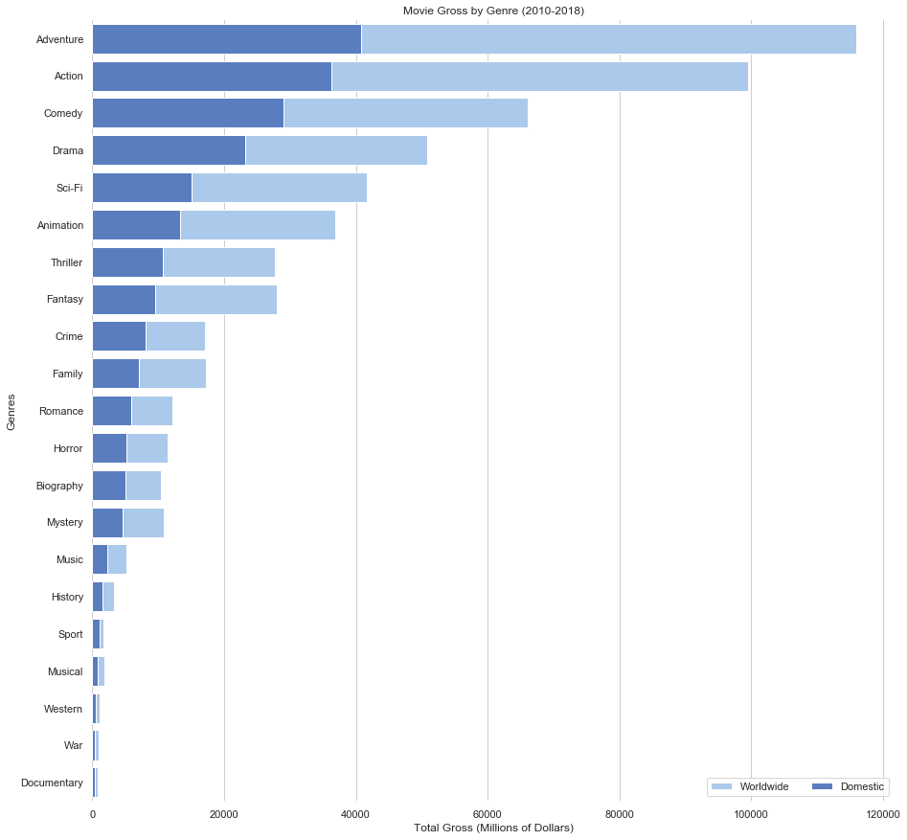
How much money has each genre made?
 | A | B | C
Yellow | 10 | 20 | 7
Blue | 30 | 15 | 10
Orange | 5 | 24 | 16
Adventure and action are the most profitable genres domestically and internationally.
I recommend focusing on action and adventure movies to make the majority of your profit.

Slide 8
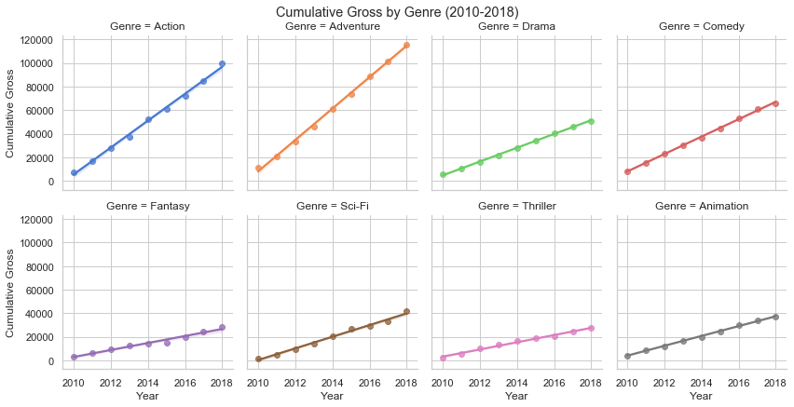
The current highest grossing genres are on track to continue their profitability.
I recommend making movies in these genres in order to maximize profits.

Slide 9
Do movie ratings affect profitability?
2

Slide 10
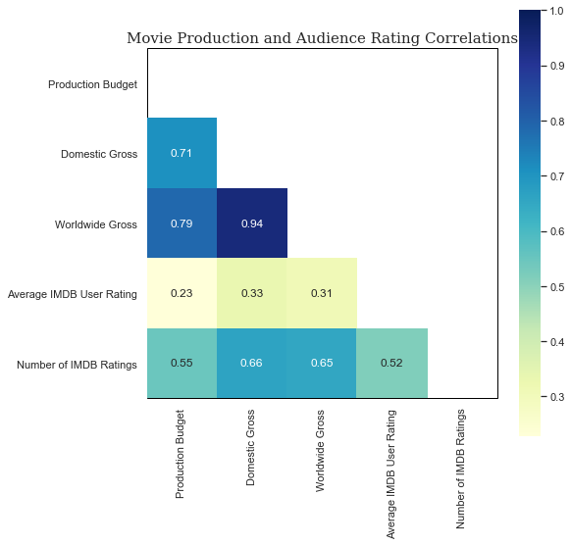
User Ratings (i.e. whether people think the movie is good) are not strongly related to profit or increased budget.
I do not recommend using subjective user ratings, which consist of a small portion of moviegoers, to make decisions.

Slide 11
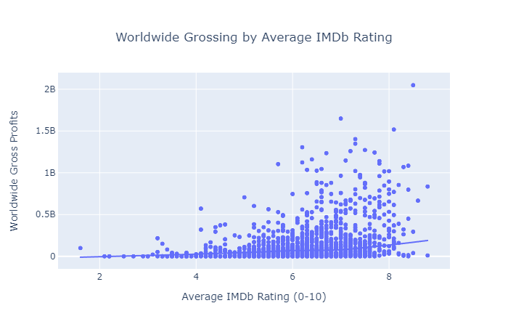
Overall ratings of movies do not have a significant effect on profit
This supports not basing movie-making choices on online ratings

Slide 12
Does a movie’s runtime affect profitability?
3

Slide 13
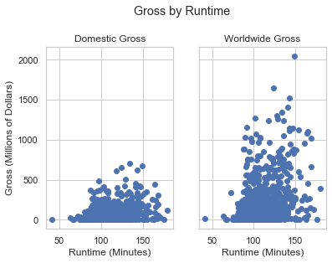
As long as a movie is more than 75 minutes long, length does not seem to impact profit.
I recommend only considering length when making a movie to ensure that it is more than 75 minutes long.

Slide 14
Conclusion
Making action and/or adventure movies increases the likelihood of making large profits. However multiple other genres are also continuing to bring in impressive box offices.
Online rating systems such as IMDB do not accurately reflect the viability of a movie.
Once runtime hits approximately 75 minutes, it is not an important predictor of profit.

Slide 15
Future Work
Franchises are an integral part of the movie industry’s profit. What attributes do successful franchises share?
Which audiences prefer what types of movies? Does this differ between domestic and international moviegoers?
What story attributes beyond genre are related to higher movie profitability?

Slide 16
Thanks!

Slide 17
Credits
Special thanks to all the people who made and released these awesome resources for free:
Presentation template by SlidesCarnival
Photographs by Unsplash

Slide 18
Appendix

Slide 19
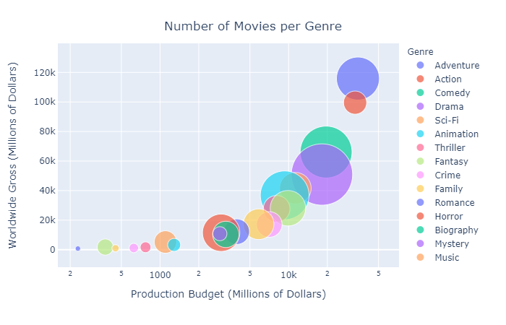
How many movies of each genre are getting made?

